Slide 1
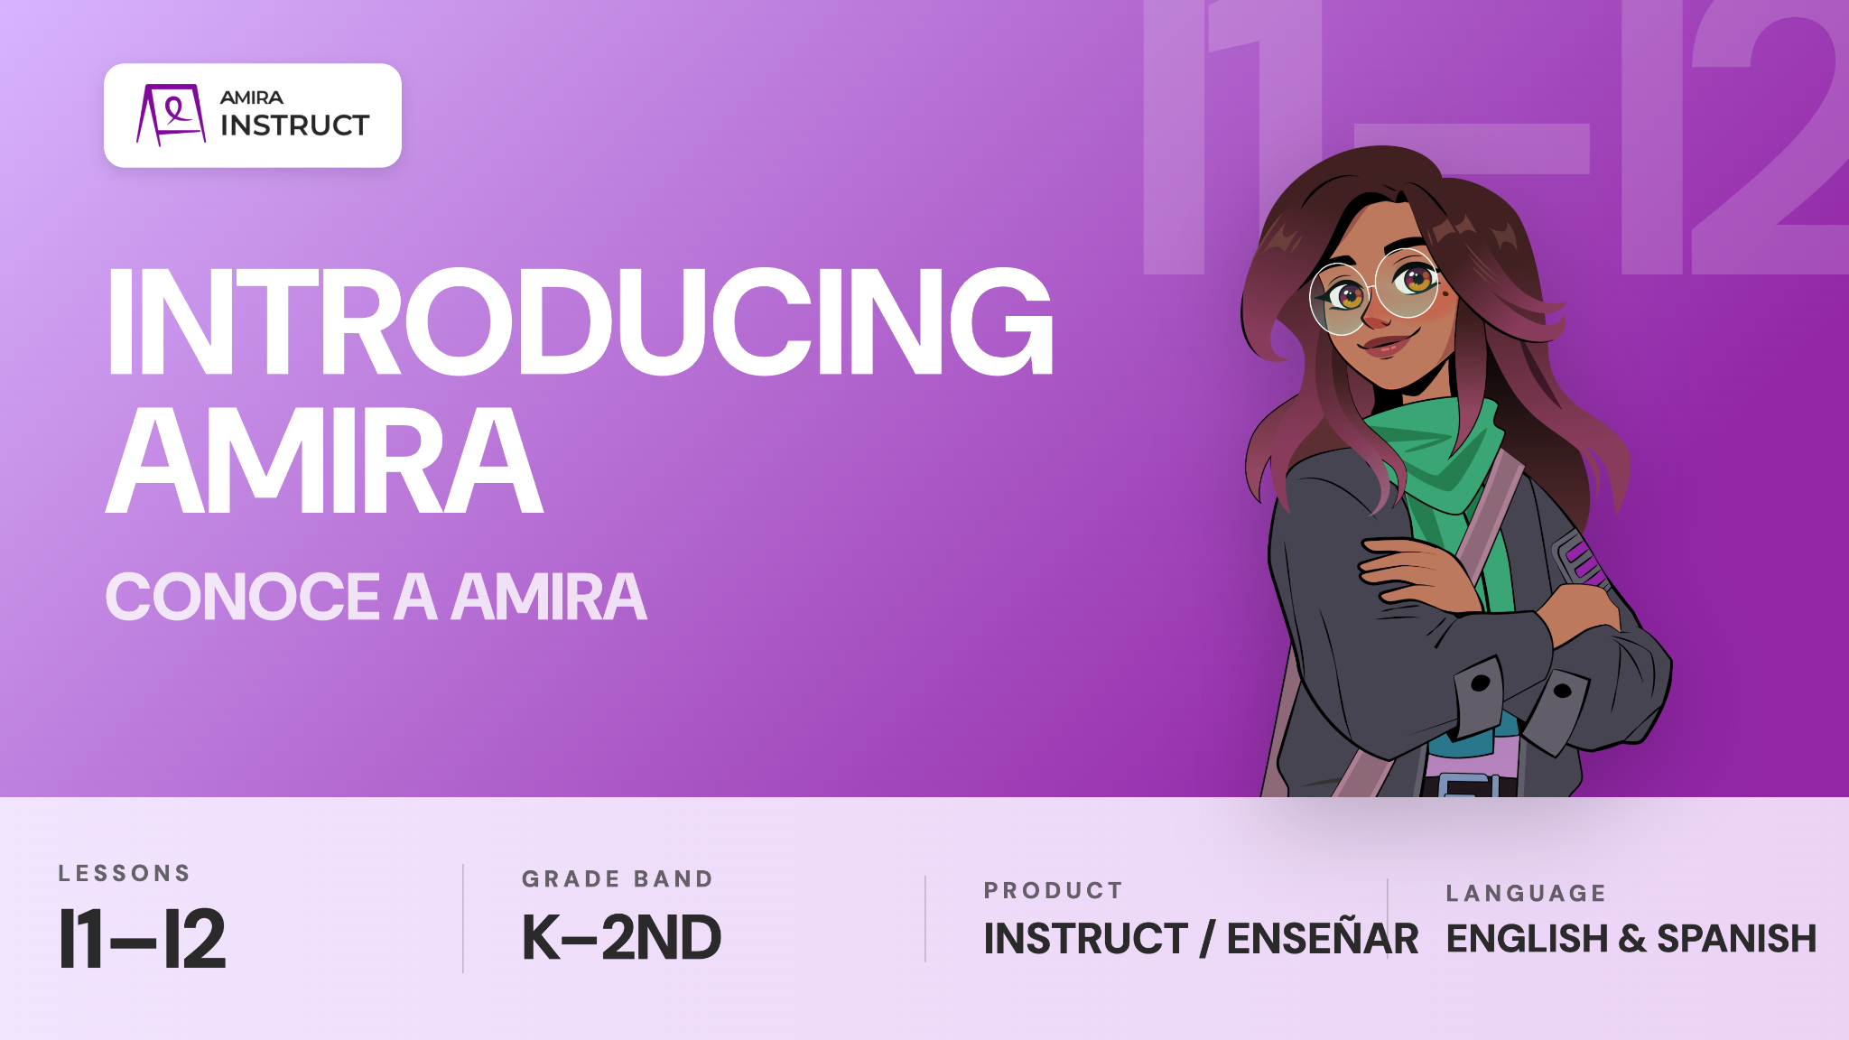

Slide 2
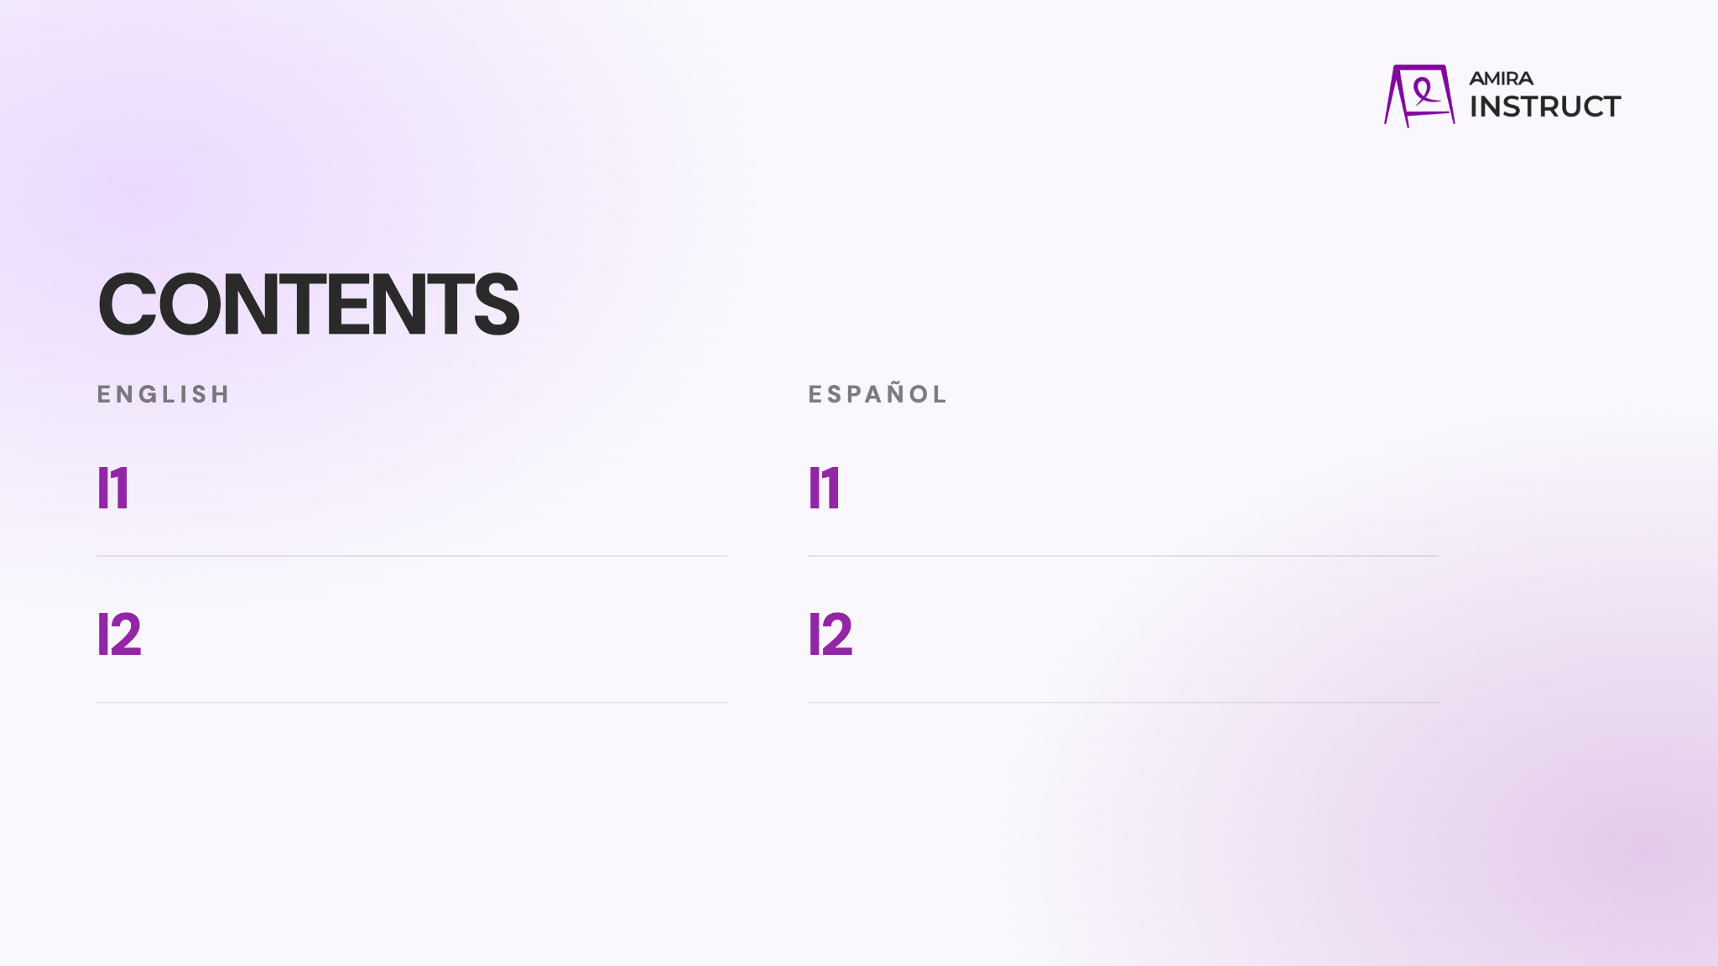
Listen and Learn
Teach students to watch, listen, and join in while Amira teaches something new.
Escuchar y aprender
Enseña a los estudiantes a mirar, escuchar y participar mientras Amira les enseña algo nuevo.
Practice
Teach students to follow directions, try their best, and complete activities with Amira.
Practicar
Enseña a los estudiantes a seguir las instrucciones, esforzarse al máximo y completar actividades con Amira.

Slide 3
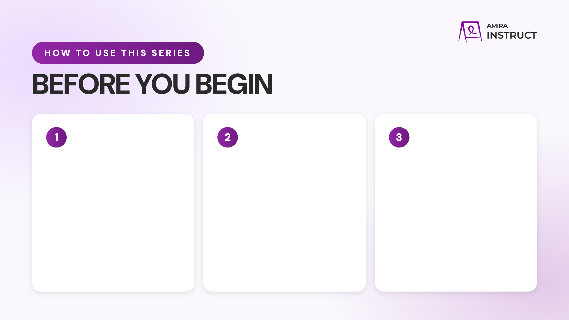
Preview the Content
Watch the videos and read through the full presentation to get familiar with the lesson flow student content.
Download the corresponding poster to display for students.
Add Custom Info
Update the prompts as needed and add any school-specific details.
Bring the Energy
Plan to introduce the series with energy and confidence. When students see that you value these routines, they are more likely to understand their importance and commit to using them.

Slide 4
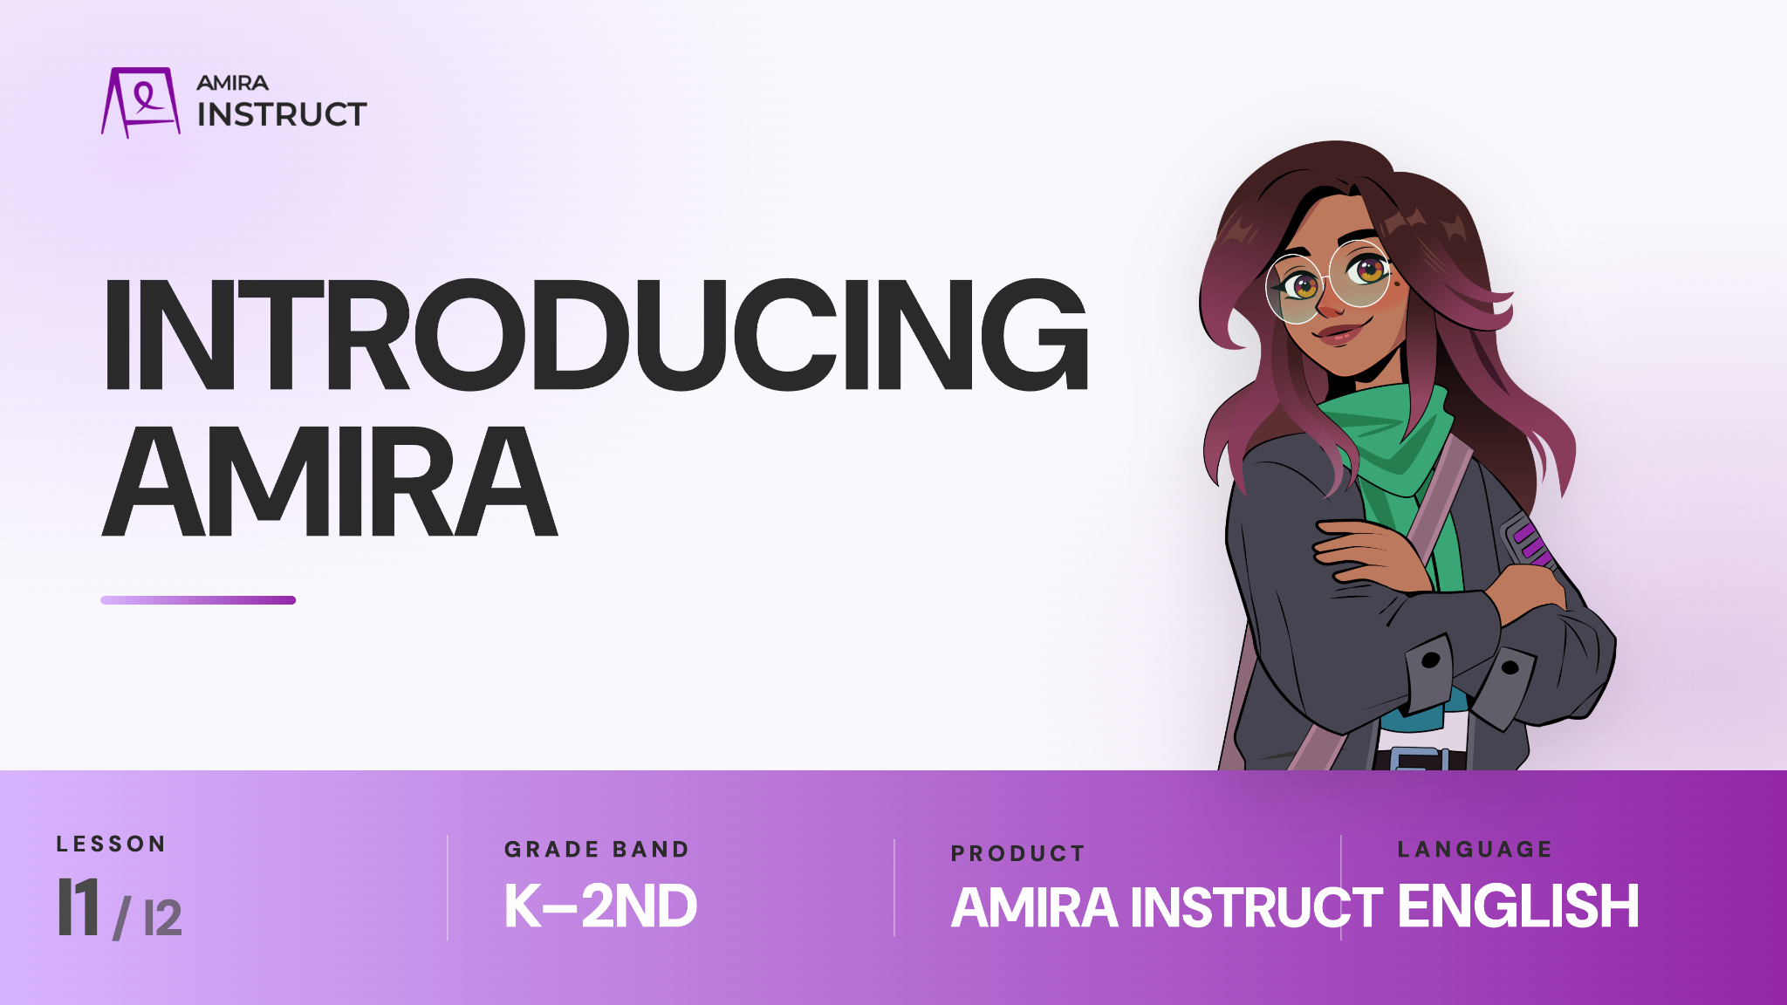
Notes:
K-2: LESSON I1
https://vimeo.com/amiralearning/k2-i1

Slide 5

Notes:
K-2: LESSON I1
https://vimeo.com/amiralearning/k2-i1

Slide 6

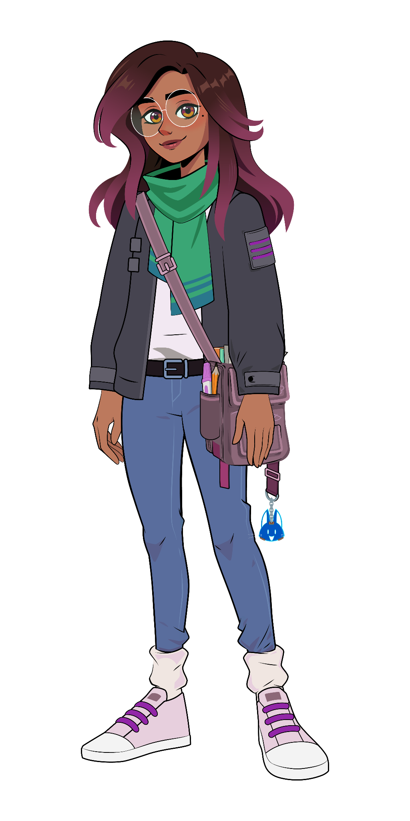

Lesson I1:
Check for understanding:
What should you do while you are watching the video?
How might Amira ask you to join in?
Think deeper:
Why is it important to listen and think about what the video is showing you?
Why should you join in when Amira asks?
Notes:
K-2: LESSON I1
https://vimeo.com/amiralearning/k2-i1

Slide 7

Notes:
K-2: LESSON I2
https://vimeo.com/amiralearning/k2-i2

Slide 8
Notes:
K-2: LESSON I2
https://vimeo.com/amiralearning/k2-i2

Slide 9
Lesson I2:
Check for understanding:
What happens in the practice part of the activity?
What should you do if you are stuck or need help?
Think deeper:
Why is it important to listen carefully to Amira’s directions?
What did you notice the student in the example did well? How could he improve?
Notes:
K-2: LESSON I2
https://vimeo.com/amiralearning/k2-i2

Slide 10
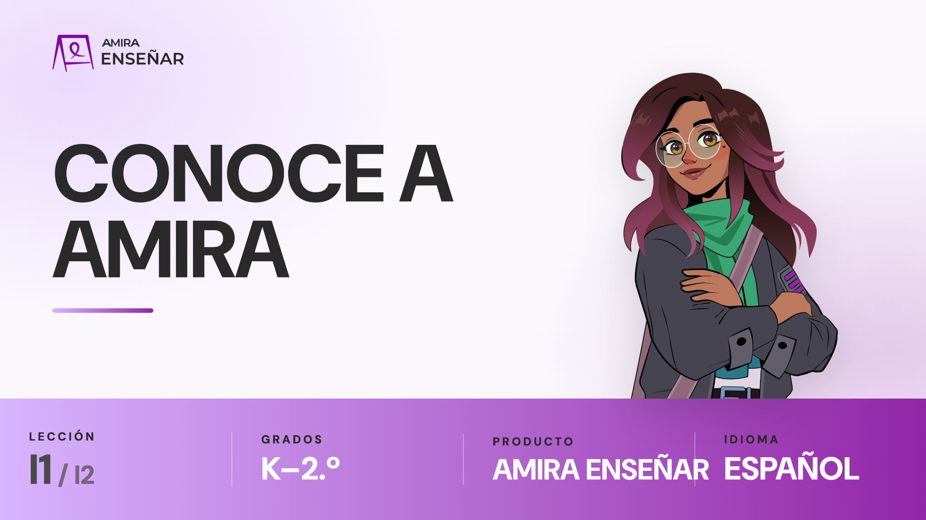
Notes:
K-2: LECCIÓN I1
https://vimeo.com/amiralearning/k2-i1-sp

Slide 11
Notes:
K-2: LECCIÓN I1
https://vimeo.com/amiralearning/k2-i1-sp

Slide 12
Lección I1:
Comprueba tu comprensión:
¿Qué debes hacer mientras ves el video?
Piensa más a fondo:
¿Por qué es importante escuchar y pensar en lo que te muestra el video?
Notes:
K-2: LECCIÓN I1
https://vimeo.com/amiralearning/k2-i1-sp

Slide 13

Notes:
K-2: LECCIÓN I2
https://vimeo.com/amiralearning/k2-i2-sp

Slide 14
Notes:
K-2: LECCIÓN I2
https://vimeo.com/amiralearning/k2-i2-sp

Slide 15
Lección T2:
Comprueba tu comprensión:
¿Qué sucede en la parte de práctica de la actividad?
Piensa más a fondo:
¿Por qué es importante escuchar atentamente las instrucciones?
Notes:
K-2: LECCIÓN I2
https://vimeo.com/amiralearning/k2-i2-sp

