Slide 1
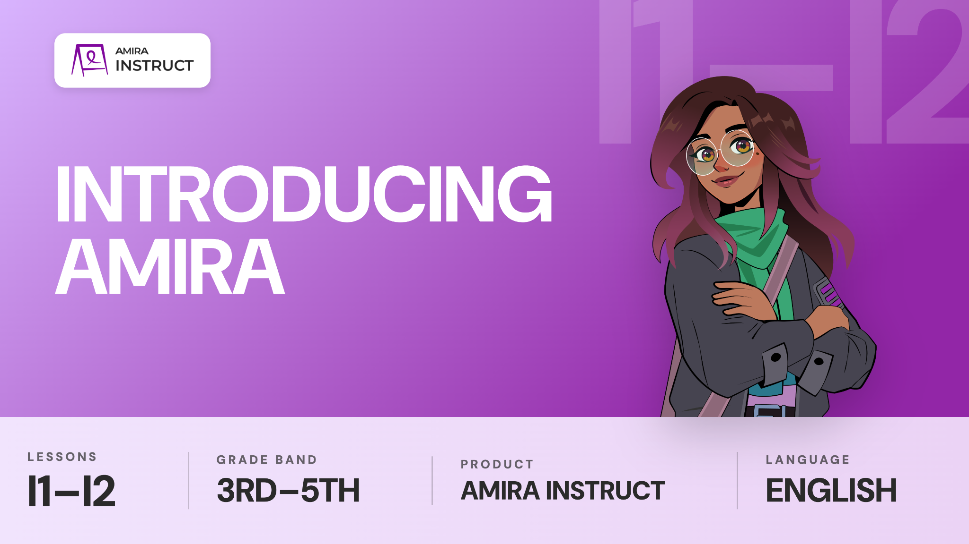

Slide 2
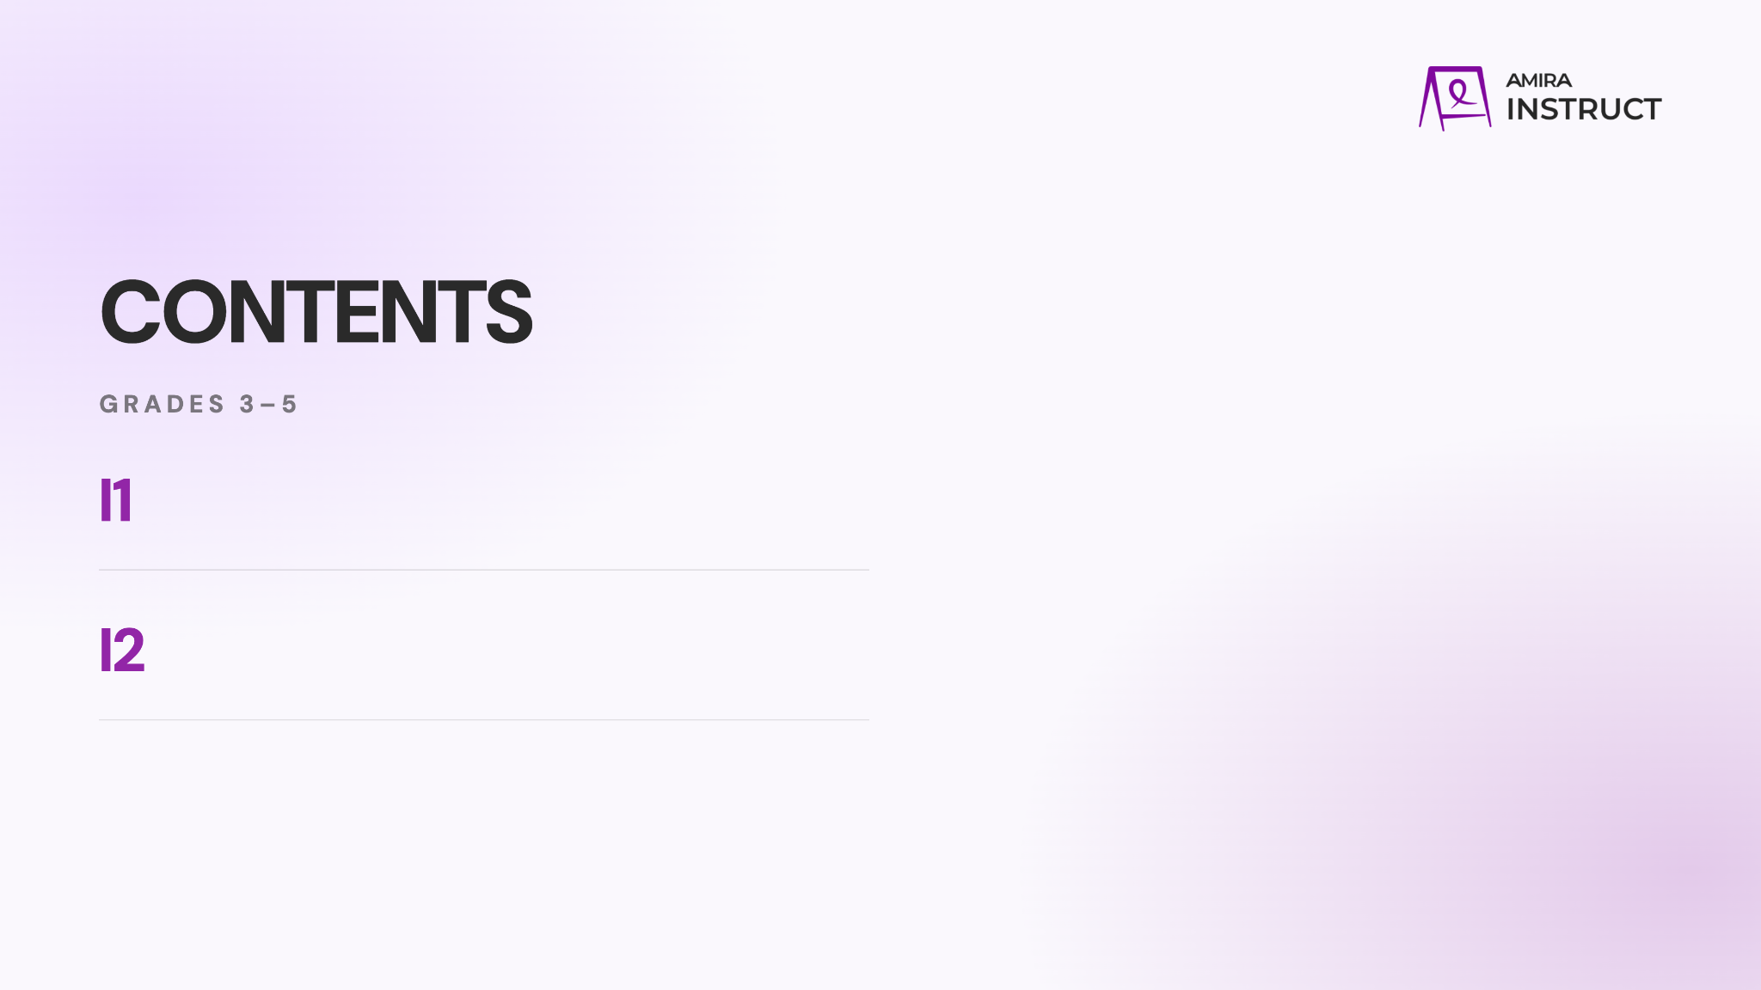
Listen and Learn
Introduce students to the learning intention, success criteria, self-assessment, and skill video.
Practice
Show students how to practice the skill, use hints or replay the video when they need help, and check their understanding.

Slide 3
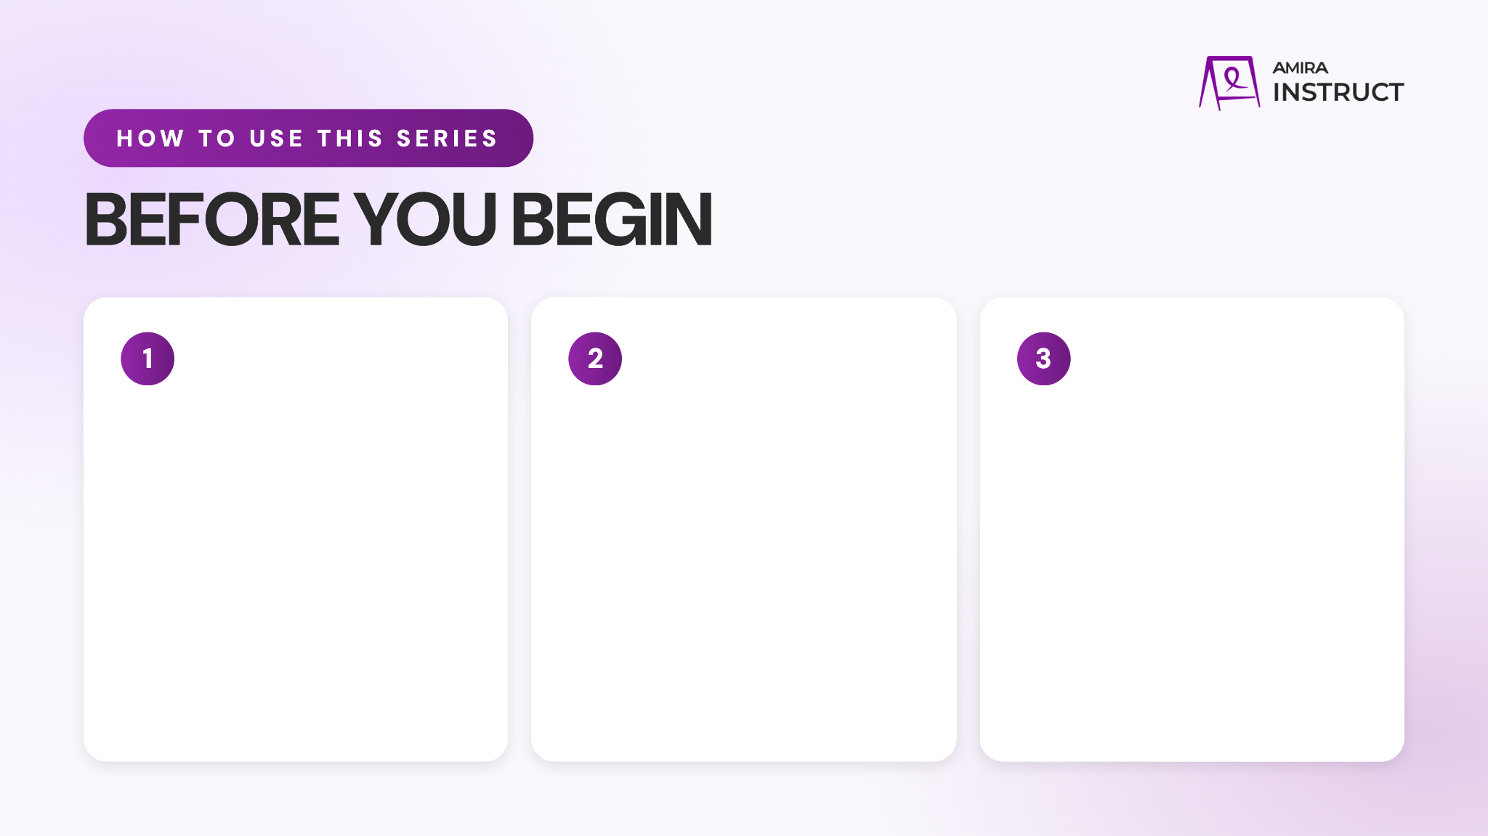
Preview the Content
Watch the videos and read through the full presentation to get familiar with the lesson flow student content.
Download the corresponding poster to display for students.
Add Custom Info
Update the prompts as needed and add any school-specific details.
Bring the Energy
Plan to introduce the series with energy and confidence. When students see that you value these routines, they are more likely to understand their importance and commit to using them.

Slide 4
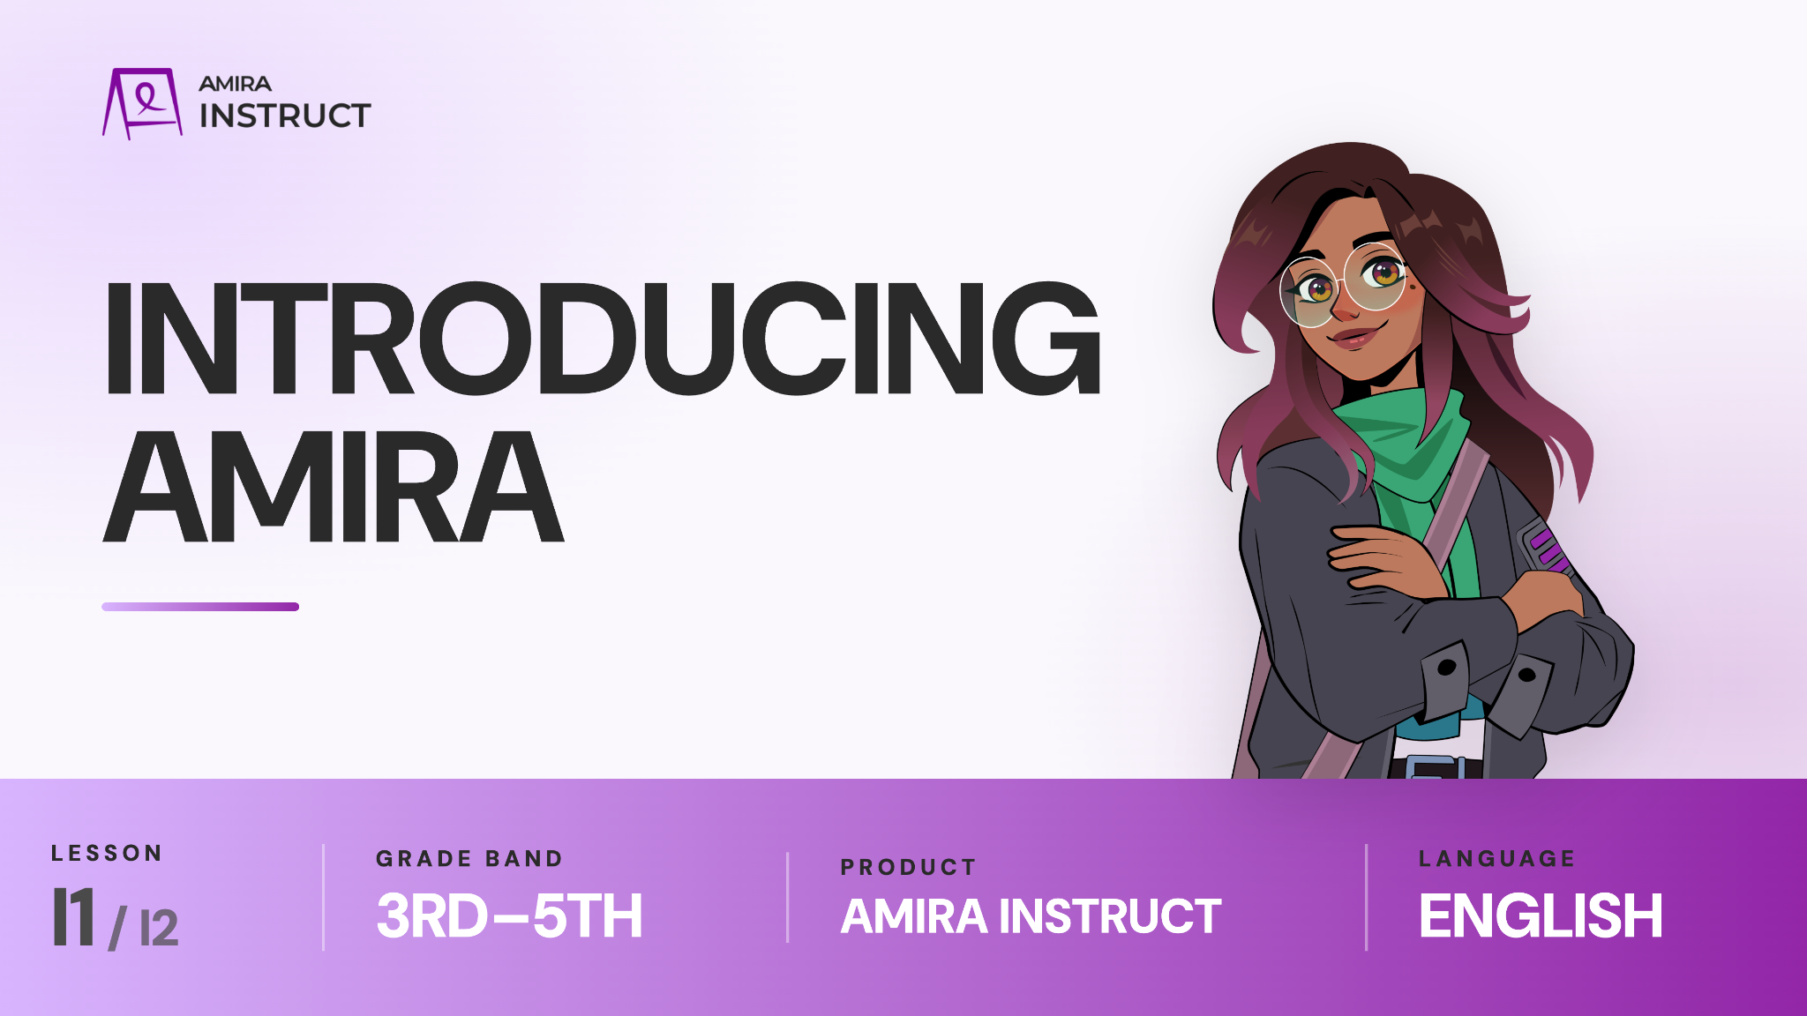
Notes:
3-5: LESSON I1
https://vimeo.com/amiralearning/35-i1

Slide 5

Notes:
3-5: LESSON I1
https://vimeo.com/amiralearning/35-i1

Slide 6

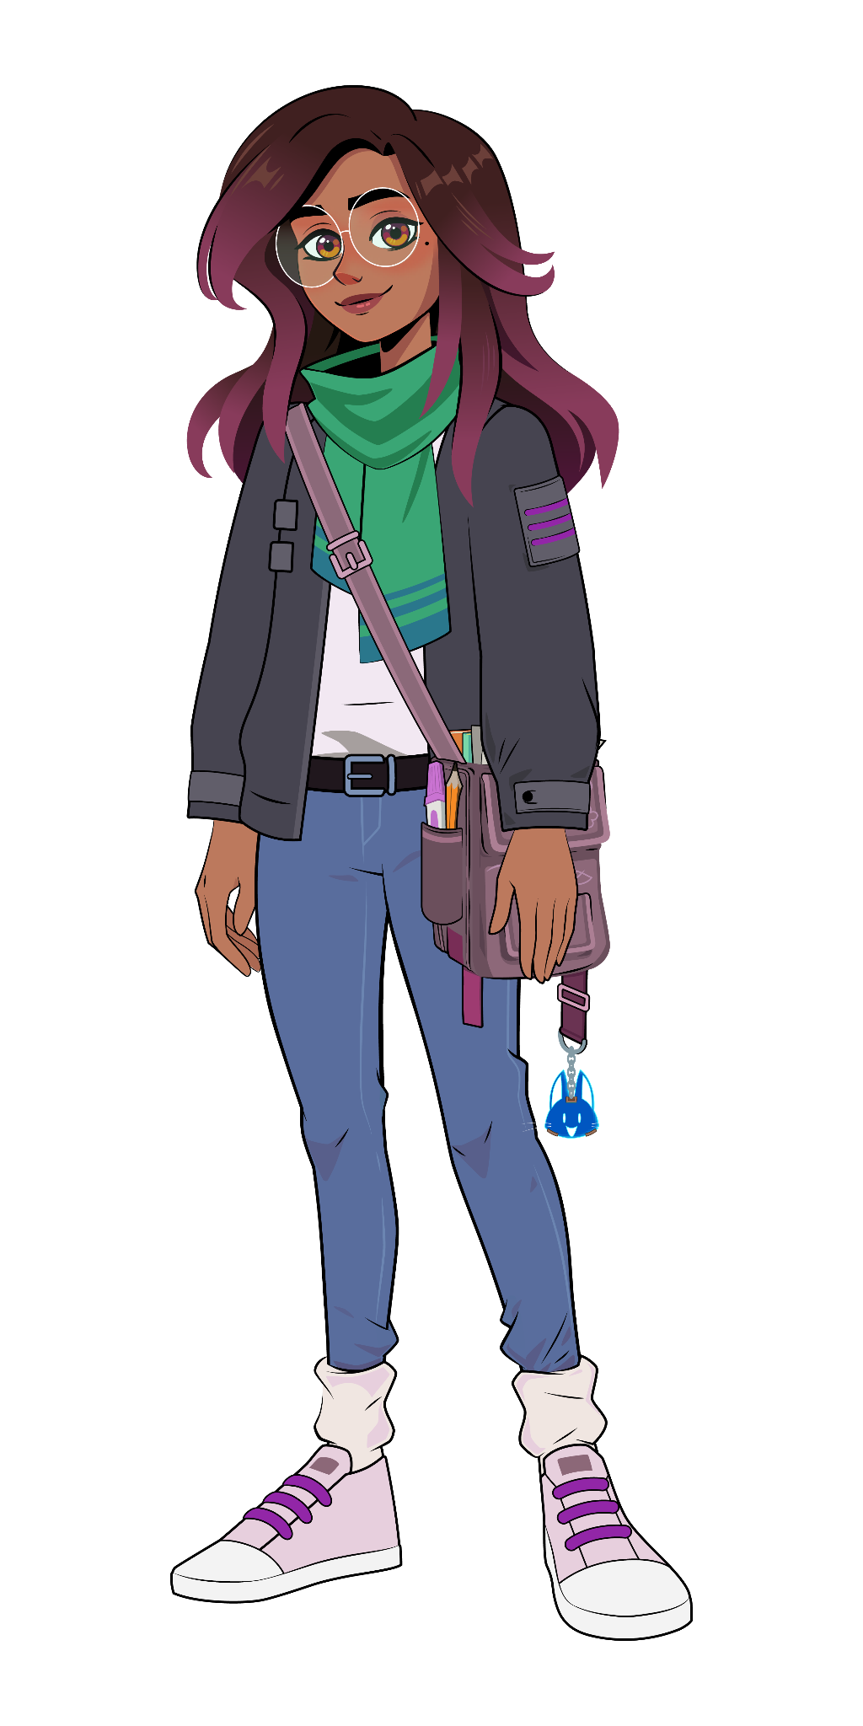
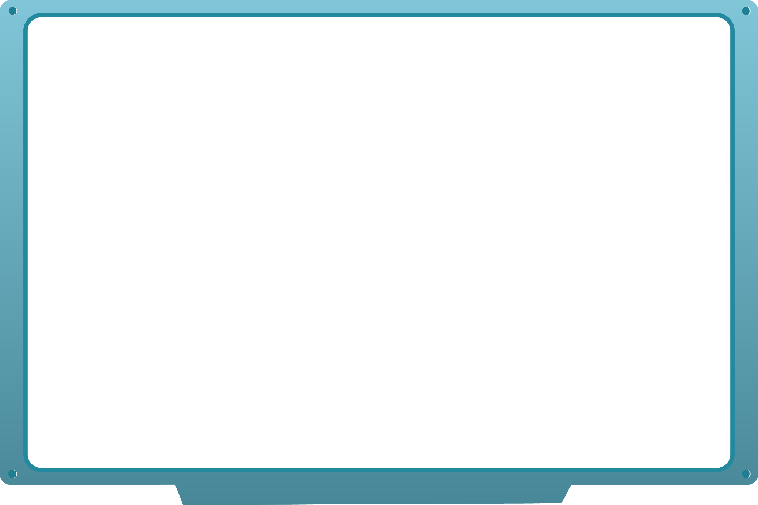
Lesson I1:
Check for understanding:
What’s the difference between the learning intention and success criteria?
What should you do while you watch the video?
Think deeper:
Why might it help to know the success criteria before you begin?
Why is it important to listen carefully while the video is playing?
Notes:
3-5: LESSON I1
https://vimeo.com/amiralearning/35-i1

Slide 7

Notes:
3-5: LESSON I2
https://vimeo.com/amiralearning/35-i2

Slide 8
Notes:
3-5: LESSON I2
https://vimeo.com/amiralearning/35-i2

Slide 9
Lesson I2:
Check for understanding:
What happens during the practice part of the activity?
What should you do if you are stuck or need help?
Think deeper:
Why is it important to listen carefully to Amira’s directions?
What did you notice happened when the student selected the wrong answer? Why is it important to read Amira’s feedback?
Notes:
3-5: LESSON I2
https://vimeo.com/amiralearning/35-i2

